Slide 1
Building Your Resource Tool Kit
Review of Rotary and District Resources
Nancy Thornton

Slide 2
rotary.org

Slide 3
Rotary Media Center - Public

Slide 4
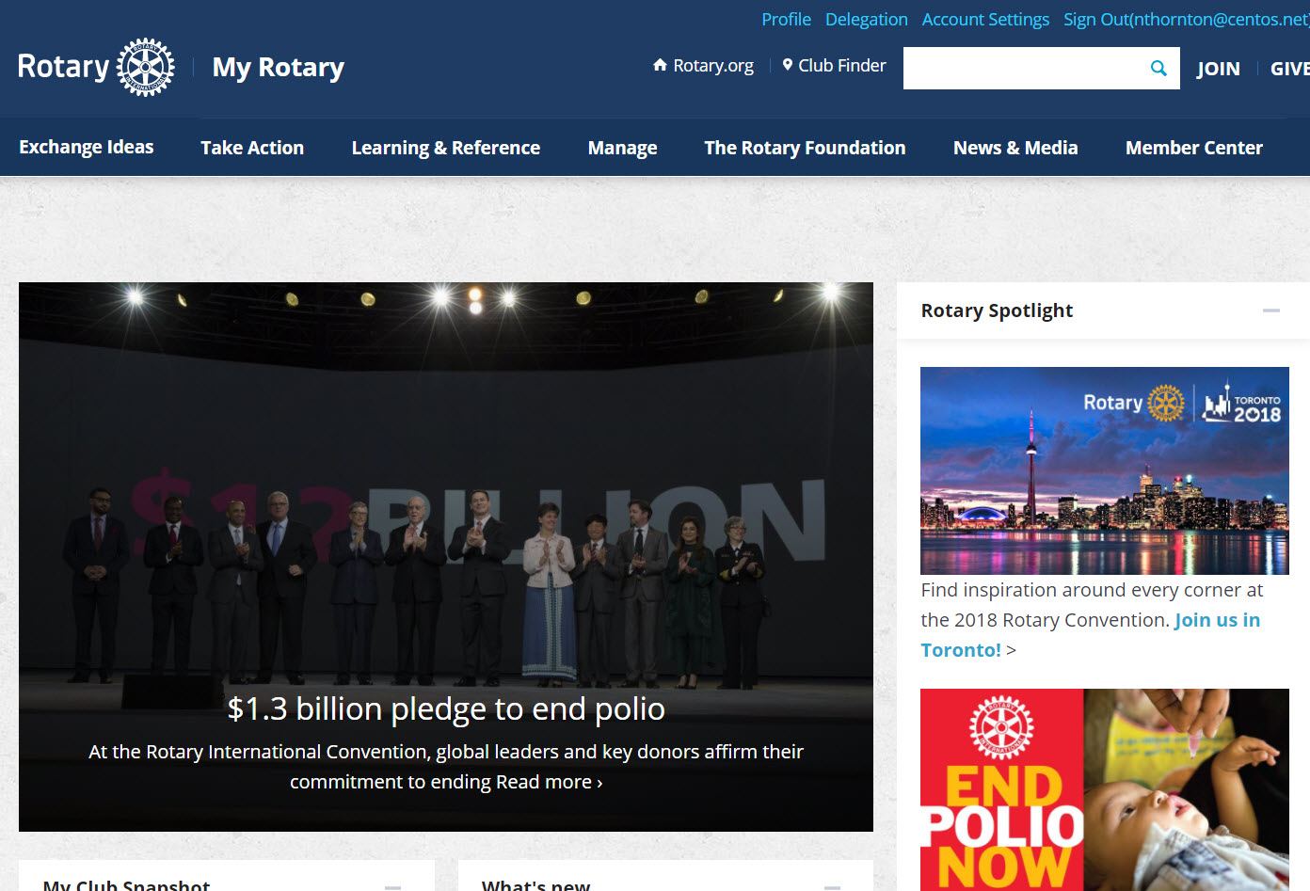
myrotary.org

Slide 5
Learning the Role

Slide 6
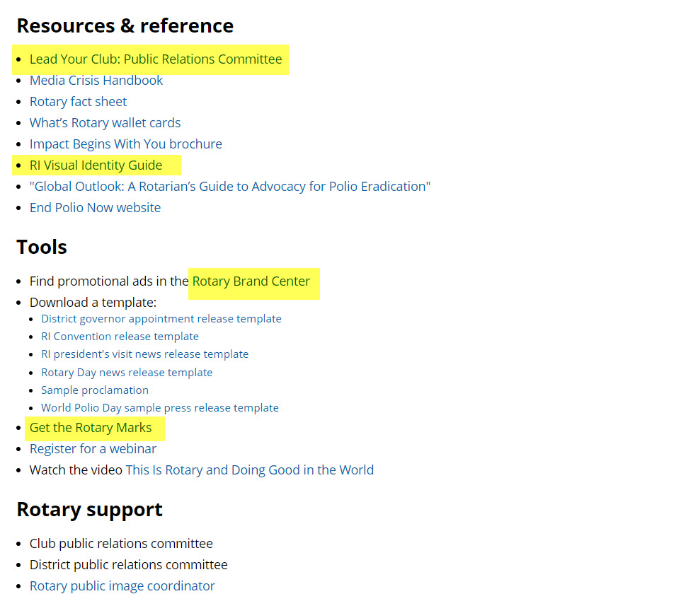
Public Image Learning Center

Slide 7
Brand Resources & Customizable Templates

Slide 8
Great Content Sources

Slide 9
Top Picks
Asset | Location/Link | Description
People of Action Video & Graphics | https://brandcenter.rotary.org/en-GB/Materials/People-of-Action | 90 second PSA and supporting graphics
No Limits Video | http://video.rotary.org/3TRE http://video.rotary.org/aGbR/no-limit-psa/ | 76 second video that tells Rotary’s story. Shorter 31 second clip also available
Membership Videos for social | http://video.rotary.org/fN4/share-your-rotarystory-3/ http://video.rotary.org/dr6n/share-your-rotarystory-2/ http://video.rotary.org/eD3u/share-your-rotarystory/ | 82 second video where members of Club 99 in Little Rock, AK show the new face of Rotary. Two 15 second clips also available.
Event Planning Guide | Brand Center | 10 page guide for planning Rotary events (PDF)
Impact Begins with You | Rotary Shop | Prospective member tri-fold brochure

Slide 10
Customizable Templates in Brand Center
Asset | Description
Club Brochure | Customize text and upload club images.
Youth Program ‘Rack Card’ | Front/Back ‘rack cards’ for Youth Exchange, Interact and Rotaract. Text is fully customizable. Select from a library of available images.
Club and/or Club Program Logo | Features Rotary ‘Masterbrand Signature’ with correct font and colors
Event Fliers | Downloadable as PowerPoint file for customization
Banners | Downloadable as PDFs for further customization
Membership Resources | Member Certificate, Member Card, Business Card

Slide 11
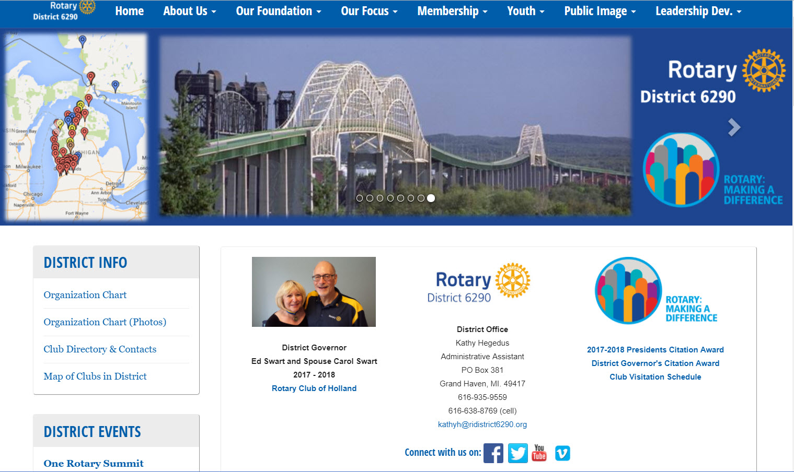
ridistrict6290.org

Slide 12
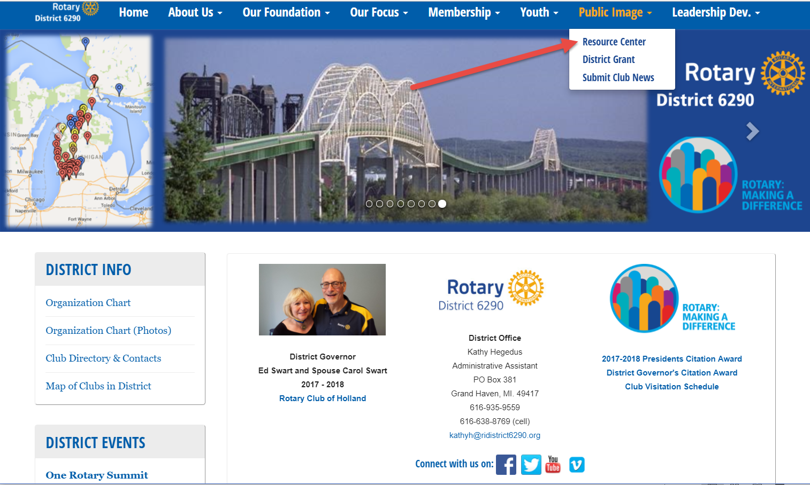
District 6290 – Public Image Center

Slide 13
Public Image Resource Center
Top
Picks

Slide 14
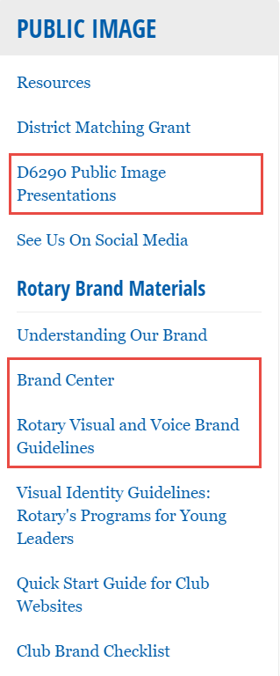
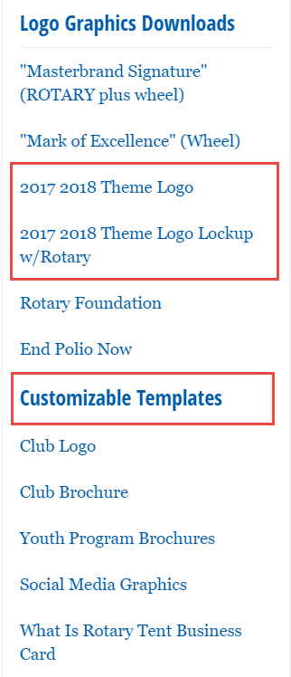
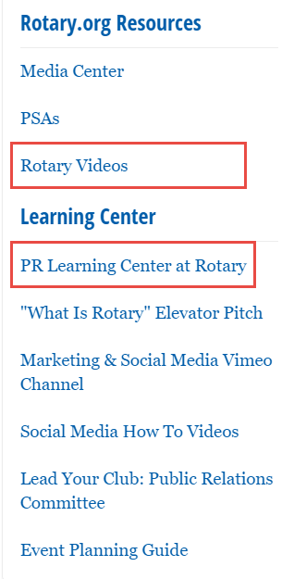
One-Stop-Shopping

Slide 15
Recent Training Events

Slide 16
on line

Slide 17
D6290 Facebook Group for Public Image
https://www.facebook.com/groups/RIDistrict6290PublicImage

Slide 18
Tools for Digital Marketing
Name | Description
 | Single dashboard to manage multiple social media channels
 | Free photo editor
 | Simple graphic design tool with templates for all social media channels
 | Generates shortened URLs when character count is at premium
 | Free tool to create online form
 | Tool to help with video creation (starts at $8/month)

Slide 19
questions?

Slide 20
Thank You
Building Your Resource Tool Kit
Nancy Thornton
D6290 Public Image Coordinator
nthornton@centos.net or 248 520 0614

