Slide 1
Rotary – Our ‘new’ look and sound
Rotary International Branding
Nancy Thornton

Slide 2
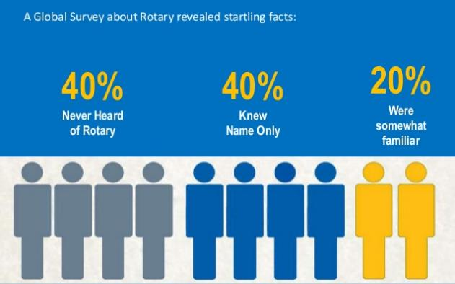
The Reality Check
Notes:
The fact is…many people do not know Rotary. Those who do only know our name or have a only a general idea of what Rotary is and does.
We got some great insights from Rotary’s own Public Image Surveys in 2006 and 2010,* which reached a wide cross-section of prospective members around the world.
The research found:
Four in 10 have never heard of us.
Another four in 10 have heard of our “name only.”
Only two in 10 claim to have “some familiarity” with Rotary. Unfortunately what much of this group knows is often colored by misperceptions and half-truths.
[FOR REFERENCE ONLY.]
*Research: Rotary Public Image Surveys completed 2006 and 2010. Responses received from six nations: Argentina, Australia, Germany, Japan, South Africa, United States. Surveyed approximately 1,000 individuals in each of six nations by phone and online. Survey has a +/- 4% margin of error.

Slide 3
Our Look
Notes:
It can be hard to break with traditions . . .

Slide 4
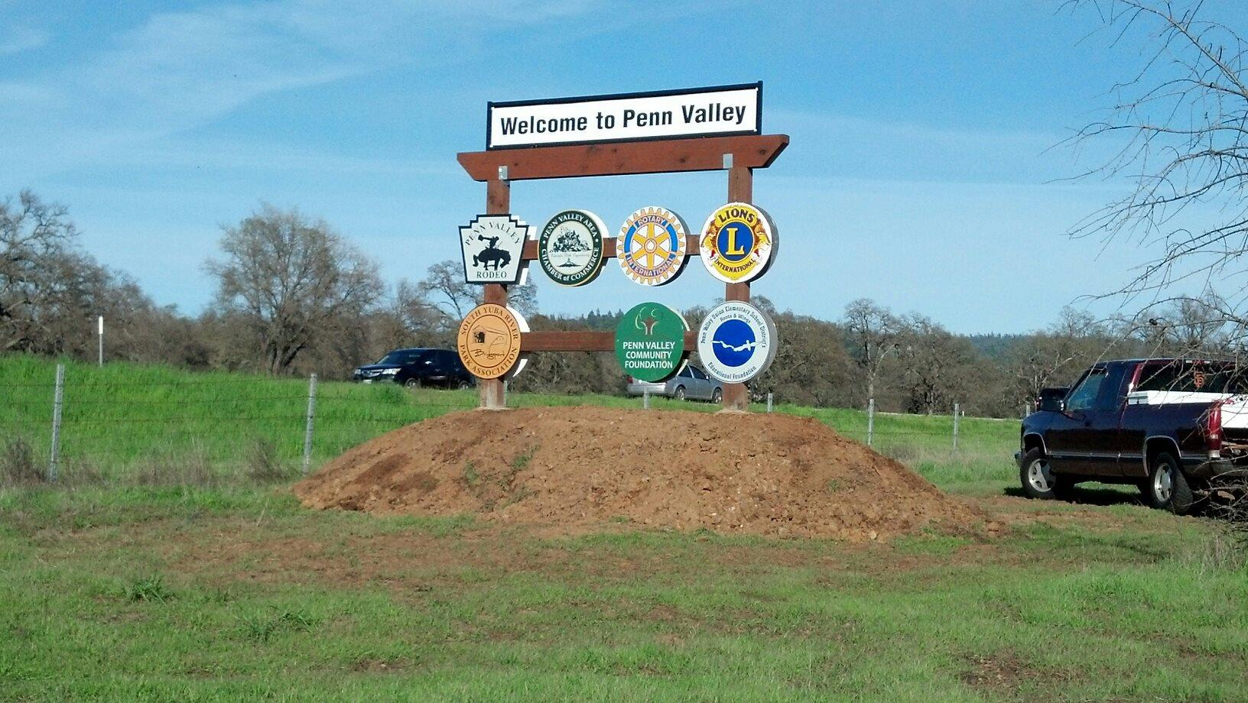
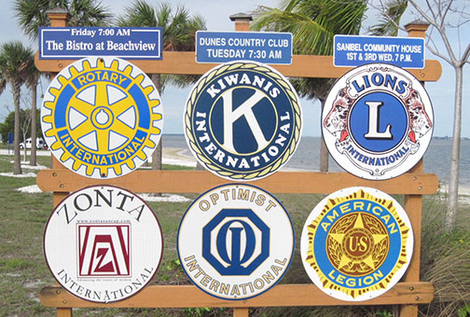
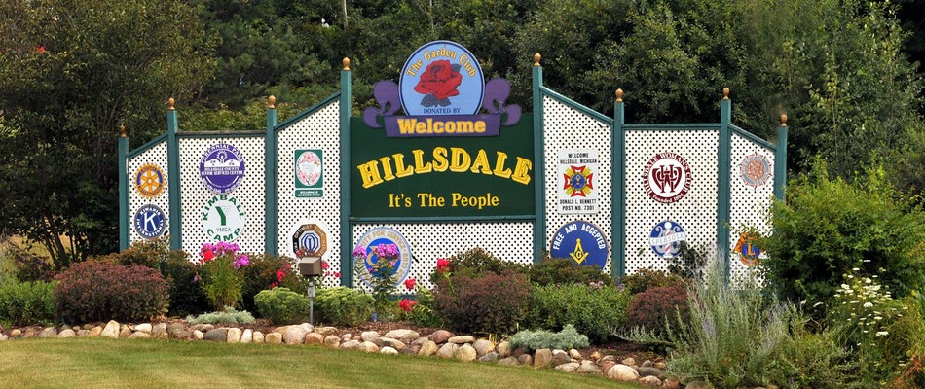
Drive-By Branding
Notes:
How many towns have you driven into where you saw a sight like this . . . .
Who are these signs for in the first place? Members only?
Think about how fast you may have been driving . . . if you aren’t already a member or otherwise familiar with the logo, would you immediately pick up the full name?

Slide 5











Personalization
Notes:
Our clubs have had a great time creating their own personalized logo . . .
But if we are trying to project that we are members of a massive, global organization with shared vision and values, is that necessarily the most unifying approach?

Slide 6





Multiple Unrelated Program Logos
Notes:
And to further add to the confusion – Rotary has had several special programs, each with its own logo, some of which made no reference at all to Rotary.

Slide 7

Perilous Google Search Results
Notes:
If you simply go out and search for Rotary Official Logo, you’ll get countless iterations of the ‘legacy’ wheel many of which were never approved to begin with.

Slide 8



Our Masterbrand Signature and Mark of Excellence
Notes:
Our Rotary Wheel is highly recognizable – but the words Rotary and International were not. As part of the update, the wheel is now known as our “Mark of Excellence” and the blue inner rim is gone. Yes – this has caused lots of talk – “it doesn’t show well” – so the cure is simple, put it against a dark background!
In fact, Rotary prefers that if we have only one opportunity to show our ‘brand’ it is not going to be that standalone wheel.
For the past 3 years, our official signature (logo) consists of the word “Rotary” beside the traditional Rotary wheel…to make the word “Rotary” more prominent.
There will be a variety of color combinations used for best graphical representation, but it is important to note that the Rotary wheel—our mark of excellence—will remain prominently displayed in our publications and materials.

Slide 9
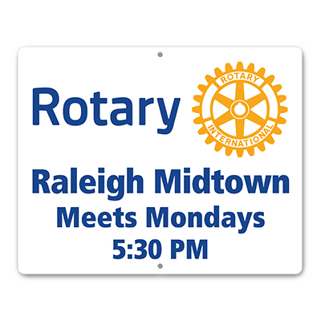




Consistency Reinforces The Brand
Notes:
At rotary.org we’ve been given access to the “Brand Center” which includes an easy-to-use ‘make your own’ club logo that will incorporate club name, but preserves the Masterbrand Signature coloring and font scheme to maximize consistency.

Slide 10





Synergy Across All Rotary Programs
Notes:
The new look was carried through to all the related programs that, previously, had their own unique look.
Once again – consistency – driving home the look.

Slide 11
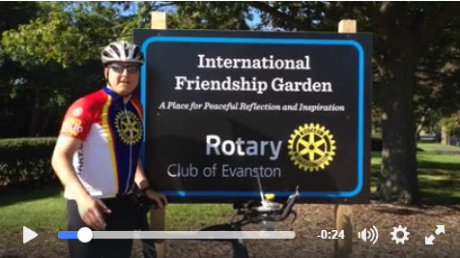
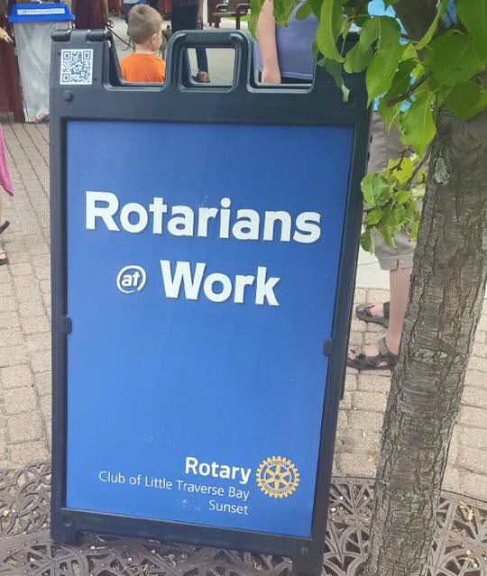
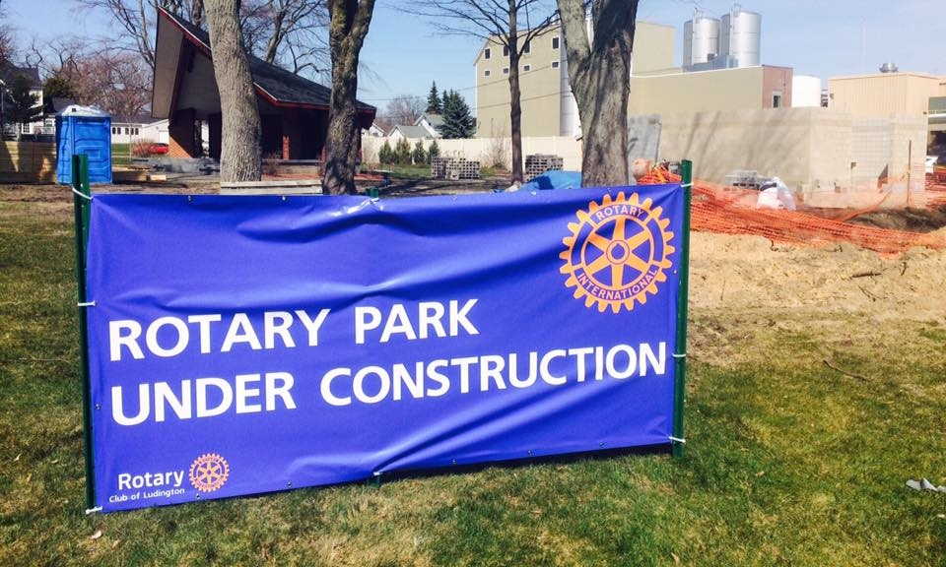
We Appear More Current
Notes:
And the new look is bright – it’s bold – and it puts Rotary face forward

Slide 12
D6290 Club Adoption Rate - Websites
40% Current
60% Dated / Nonexistent
Notes:
As of October 2016, four years after the new branding was released, only 40% of our 60 club websites are reflecting the new branding.
We have some work to do.
For the vast majority of our clubs, it doesn’t cost a thing to swap out graphics at a website. It is your most public face to the community, and it deserves a face lift.

Slide 13
Our Voice
Notes:
Just as important as our updated, streamlined look is our need to talk about Rotary in updated ways.

Slide 14
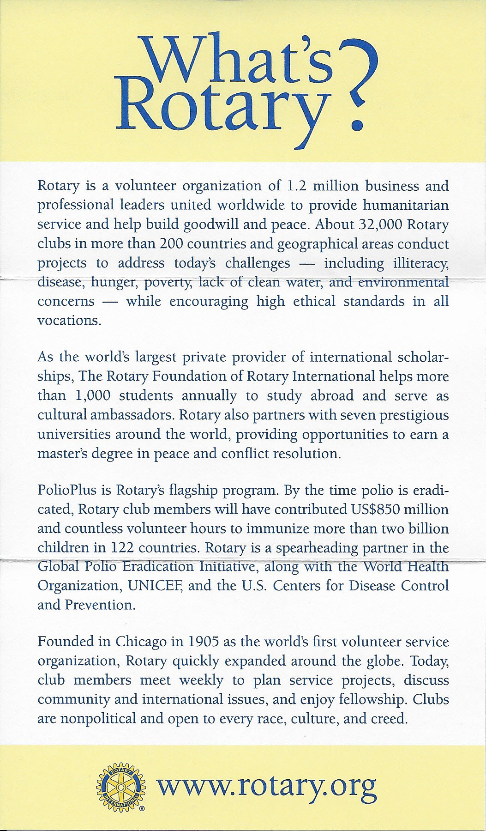
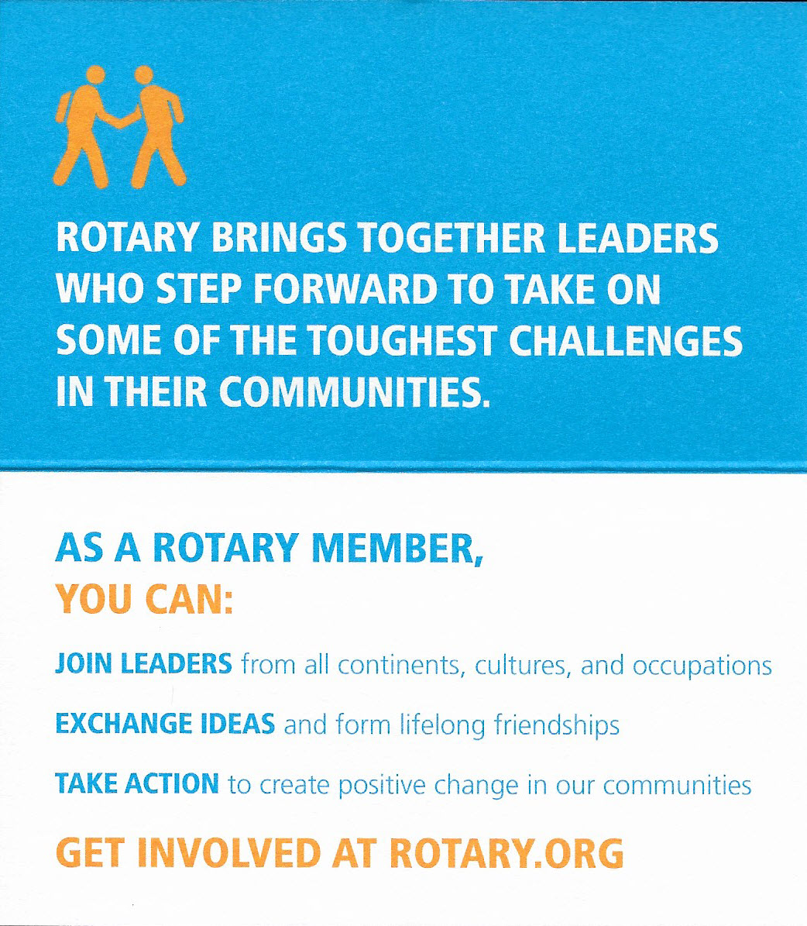
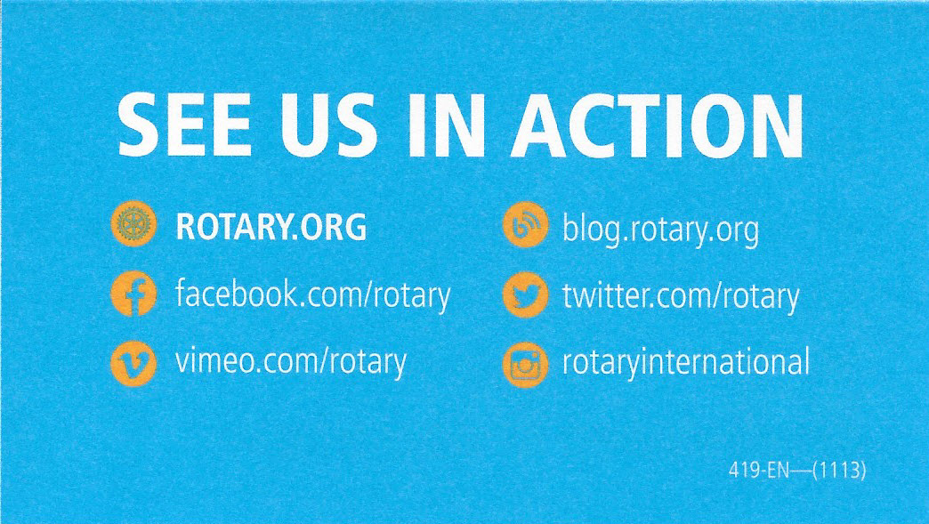
What’s Rotary?
Notes:
A popular promotion piece many Rotarians have carried in their wallets is the “What’s Rotary” business card. Well, not exactly a business card – originally a tri-fold that ended up that size, but had lots and lots of room for us to wax on about us . . .
We described ourselves in lengthy, formal, passive terms.
Today, we need to shorten our narrative and get to meaningful points that a prospective member might care about. We use upbeat, more contemporary terms and we speak in an ACTIVE voice because after all, we are Rotarians . . . And there’s simply nothing passive about us!

Slide 15
Our Updated Voice
Notes:
Here’s a great example of how we’ve transitioned from a more formal, 3rd party, passive voice to an invigorated, active, first person active voice.
It’s more compelling . . .

Slide 16
Who We Are
Notes:
As part of the major branding initiative Rotary undertook – we had to define what Rotary is, and what makes Rotarians unique. All the inputs tended to cluster in three areas:
Rotarians are leaders – not because of their title or position, but because of their mindset
By connecting with others we realize the full power of Rotary – it isn’t so much a network of individuals . . . it’s about forming a web of connections across all walks of life
When we engage that web of connections, we make a sustainable impact in our local/global community

Slide 17
Our Essence and Organizing Principles
JOIN LEADERS
EXCHANGE IDEAS
TAKE ACTION
Notes:
Rotary joins leaders…we are a catalyst for collaborating and improving our communities.
We exchange ideas…bringing our expertise and our diverse perspectives to bear on community problems.
Then…because ideas are only the first part of the solution and Rotarians are interested in solving problems…Rotarians take action.
By taking these three thoughts…JOIN LEADERS….EXCHANGE IDEAS…AND TAKE ACTION…we can help every Rotarian to create their own “elevator speech” that reflects their personal Rotary experience and culture as well as these three attributes.
For instance…my elevator speech is (JUST AN EXAMPLE):
“Rotary brings together successful, diverse and influential community leaders who step forward to take on some of the most meaningful challenges in communities everywhere. And we do this community-by-community around the world.”

Slide 18
Questions?

Slide 19
Thank You
Rotary International Branding
Nancy Thornton

