Slide 1


Slide 2
Introduction
2017 WORLD PEACE CONFERENCE
Ashish Sarkar, Convener
Rotary Club of Ann Arbor, District 6380

Slide 3
Rotary Works for Peace
Exciting opportunity for Rotarians to come together to discuss Peace and Conflict Resolution issues that we face in the world today.
Raise awareness about these issues in our communities
Conference will be open to other like-minded organizations and community members

Slide 4
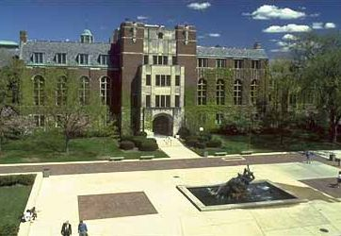
Peace Conference Details
Friday, March 31 and Saturday, April 1, 2017
  Michigan League
  University of Michigan
  Ann Arbor, Michigan
600 participants

Slide 5
Peace Conference Sponsors
7 Rotary Districts in Michigan, northern Indiana, northwest Ohio and southern Ontario (representing 15,000 Rotarians)
Individual Rotary Clubs
Wayne State University Center for Peace and Conflict Studies
Regional faith-based organizations
Interfaith Council for Peace and Justice
Interfaith Roundtable for Peace and Conflict Resolution

Slide 6
Others Invited for Sponsorship
United Nations Representative
Knight Wallace Center, University of Michigan
Gerald R. Ford Museum and Library
Regional Peace groups
Foundations, Corporations, and Local Businesses
Individuals

Slide 7

Community Involvement
Rotarians and Peace Scholars
Leaders and Scholars with expertise about specific issues
University based Peace Centers
Youth including Rotaractors
and Interactors
Please
Come

Slide 8
Peace is More than Ending Wars
To truly work toward Peace, we must address the underlying issues:
Poverty/Hunger
Ignorance, Bigotry and Religious Persecution and Refugee Crisis
Violence in our Communities
Conflict in all its forms

Slide 9
Themes for 2017 Peace Conference
Peace and Conflict Resolution
Poverty, Hunger and Health
Role of Faith-based Organizations
Role of Media in Peace-Making
Preserving Basic Human Rights
Violence Prevention
Involving Youth in Peace & Conflict Resolution

Slide 10
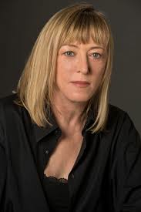
Plenary Speaker
Jody Williams
Nobel Peace Prize Laureate (1997)
Chair, Nobel Women's Initiative
“Why do we glorify violence & war
and make peace seem the
folly of fools?”
Jeffery Sachs, UN/ Columbia University

Slide 11
Rotary International Dignitaries
John Germ, RI President, 2016-17
Jennifer Jones, RI VP, 2016-17
Wilfred Wilkinson, PRIP
John Hewko, Secretary General

Slide 12

Panelists: Peace and Conflict Resolution
Fred Pearson, Professor, Wayne State University, Detroit
Owen Greene, Professor, Bradford University, UK
Drs. Sean Byrne and Jessica Senehi, Winnipeg, Canada
Robert Johansen, Notre Dame Univ.

Slide 13

Speakers: Role of Media in Peacemaking
Bobby Ghosh (Former Time Global Editor; Editor, Hindustan Times)
Penny LeGate, ( TV Anchor, KIRO, Seattle, WA)
Blake Roberts (Former CBC; Faculty, University of Windsor teaching new media)
I heard it on
the news!

Slide 14
Interactive Breakout Sessions
Fun filled interactive sessions directed toward YOUTH
Smaller groups
Focused on ACTION
Result Oriented Session
Sustainable Outcomes
And much more!

Slide 15

Peace Conference Budget
Projected Expenses: $200,000+
Speaker Fees
Facility Fees
Travel Expenses
Fixed Expenses/Other Costs

Slide 16
Funding Sources
Rotary Districts, Clubs
Corporations
Foundations
Sponsorship revenue
Individual Donors
Registration Fee
  $150 for 2-day conference
  $ 35 for youth, students

Slide 17
DONATION LEVELS: Rotary, Individuals, organizations
$10,000+ Peace Builder
$ 7,500+ Peace Maker
$ 5,000+ Peace Benefactor
$ 2,500+ Peace Partner
$1,000+ Peace Friend
<$1,000 Peace Affiliate

Slide 18
DONATON LEVELS: Rotary
7 Rotary Districts @ $5,000
14 Large (more than 60) Rotary Clubs @ $2,500
20 Medium (25-60 members) Rotary Clubs @ $1,000
100 Small (less than 25) Rotary Clubs @ $500

Slide 19
DONATION LEVELS: Corporations, Banks, Foundations,Funds
$25,000+ Platinum
(Peace Laureate or Track Sponsor)
$20,000+ Gold
$15,000+ Silver
$10,000+ Bronze
$ 5,000+ Copper

Slide 20
Call for Action
Volunteer your Time, Talent and Resources:
District, Club and/or Individual Sponsorship
Committee Participation
  Conference Organizing Committee
  Various subcommittees including fundraising,
  publicity, speaker selection, venue management
Attend the Peace Conference
. . .and encourage others to attend!

Slide 21

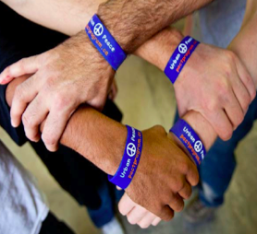
FOR MORE INFORMATION:
info@2017peaceconference.org
Ashish Sarkar
adsarkar@comcast.net
Tel: 734 834 4746
Website:
2017peaceconference.org
Facebook:
2017 Peace

